Slide 1
NAUTIVA
COMPOSITE BOATS · MADE IN VIETNAM
Mastercraft Vessels. Engineered for Excellence.
NAUTIVA engineers and manufactures composite boats for tourism, recreation, water sports, and rescue operations. Each vessel combines modern naval architecture with the craftsmanship of precision composite fabrication — built to perform across freshwater, coastal, and open-water environments.

Slide 2
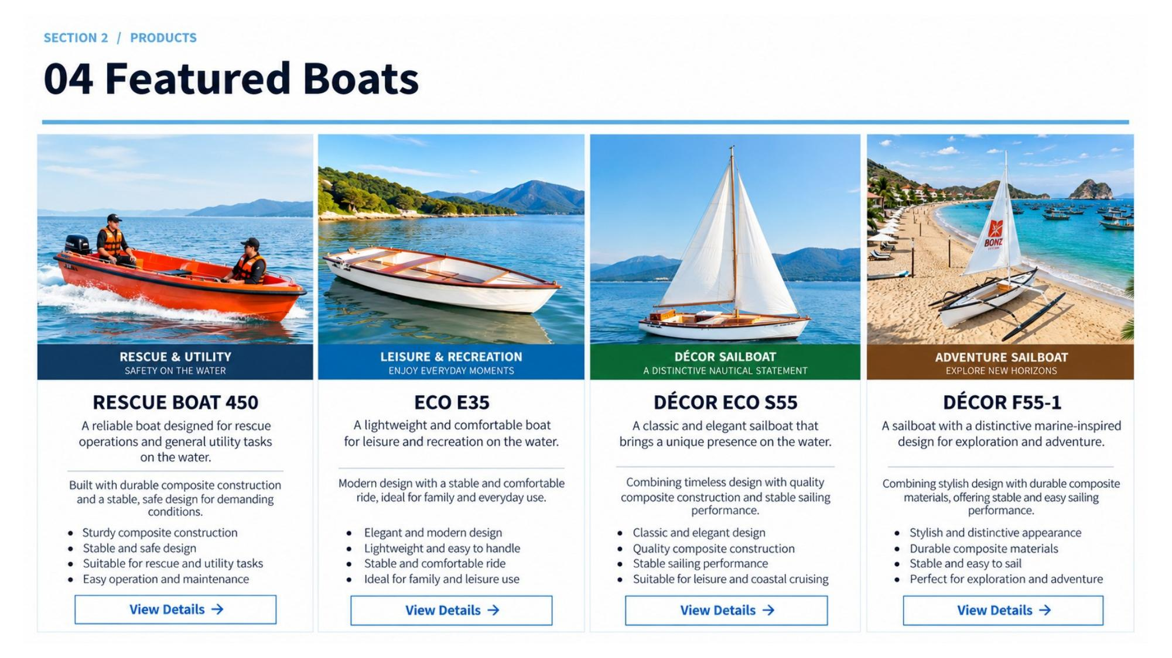
SECTION 1 · FEATURED VESSELS
Our Signature Collection
Tourism · Recreation · Sport · Rescue
NAUTIVA

Slide 3
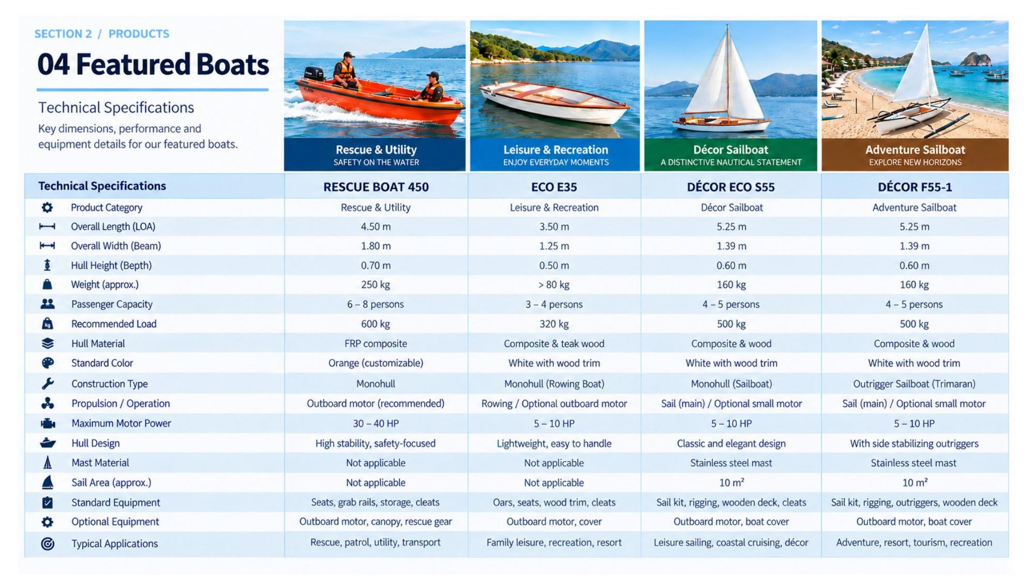
SECTION 1 · TECHNICAL OVERVIEW
Performance Specifications
Dimensions, capacity and key technical data
NAUTIVA

Slide 4
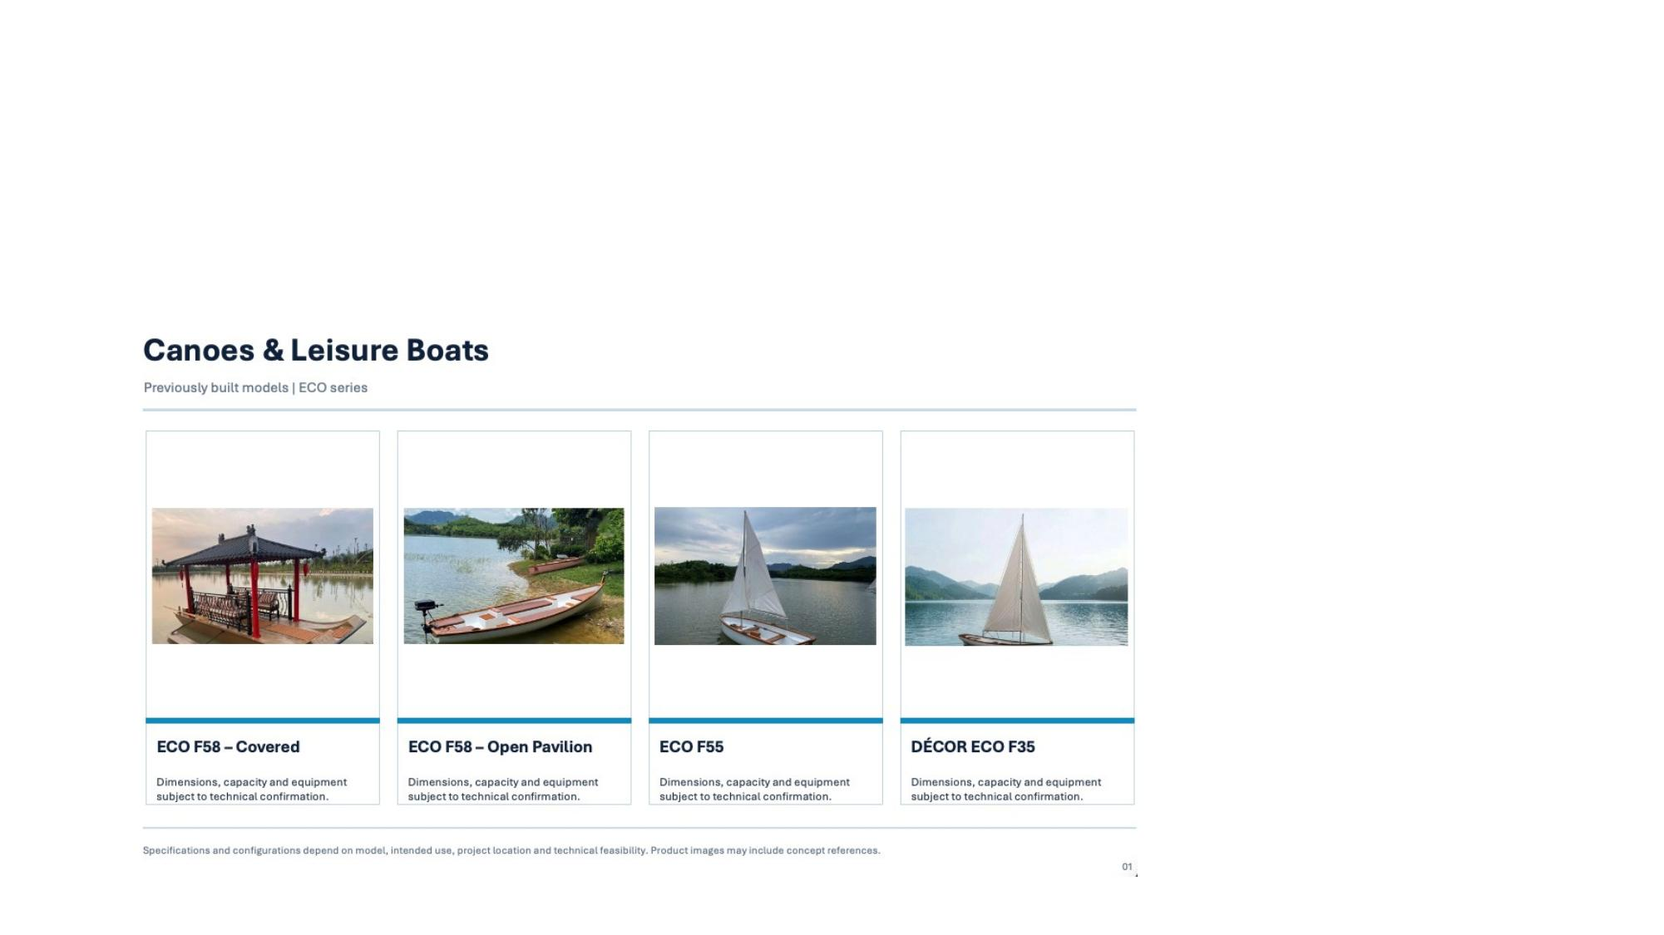
SECTION 2 · LEISURE CRAFT
Canoes & Recreational Boats
Previously built models — ECO series
Our Concepts & Future Developments
Discover our product concepts, showcasing our design vision and laying the foundation for future innovation and development.
NAUTIVA

Slide 5
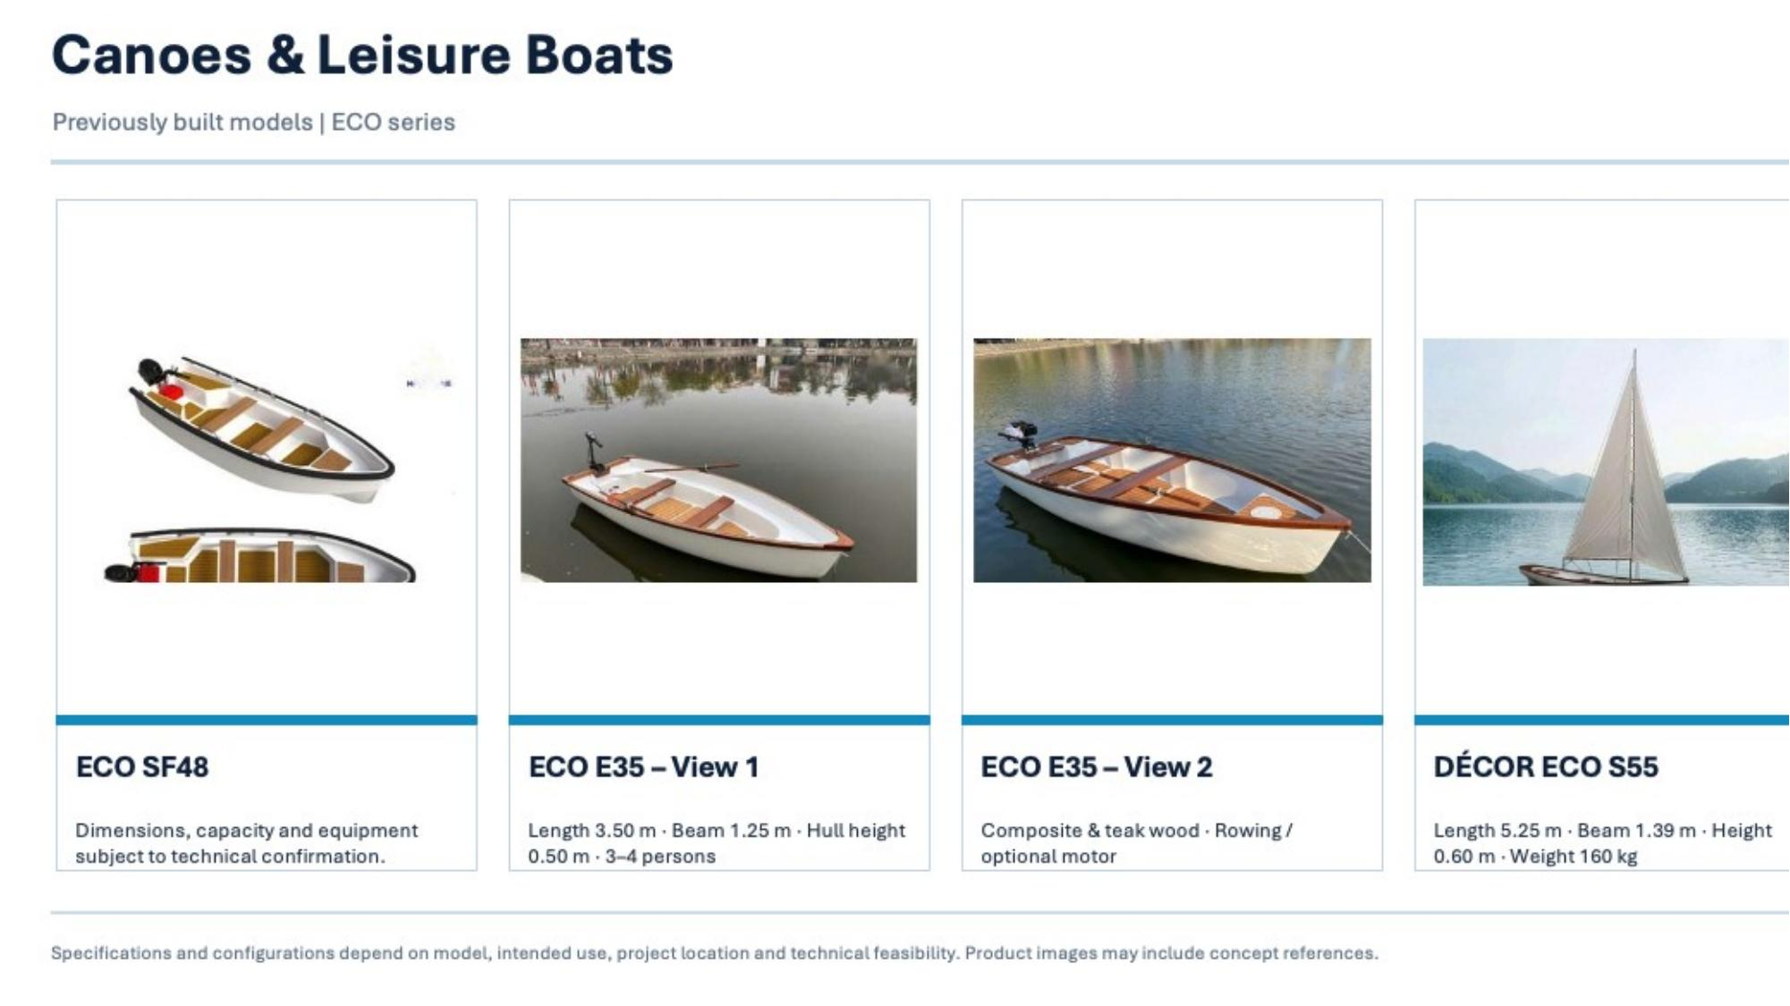
SECTION 2 · LEISURE CRAFT
Day Cruisers & Canoes
Previously built models — ECO series
NAUTIVA

Slide 6
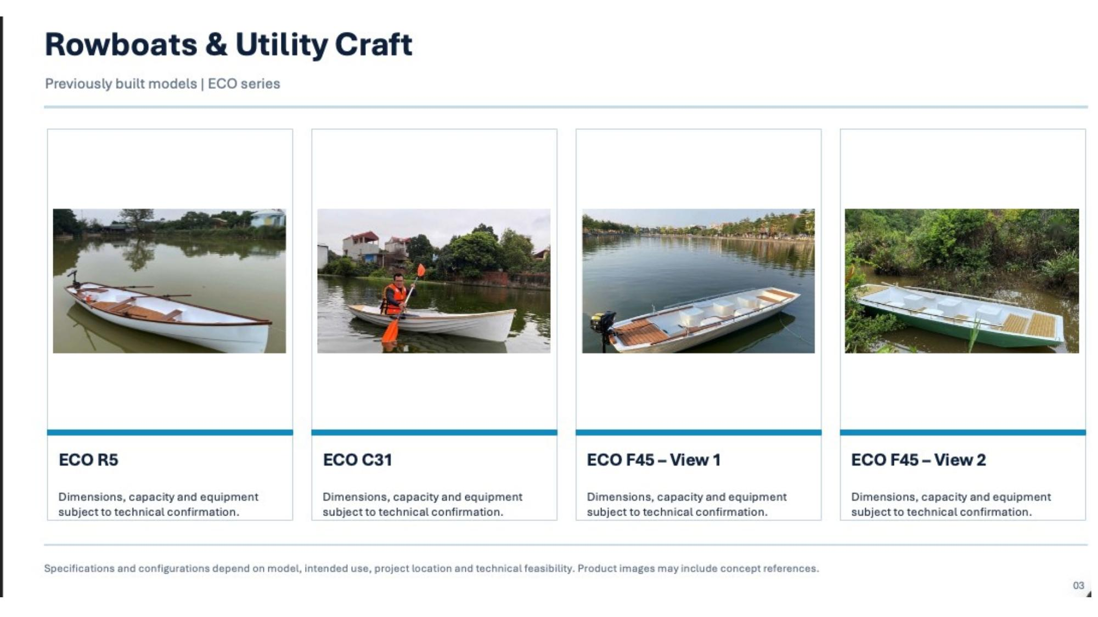
SECTION 2 · UTILITY FLEET
Rowboats & Working Vessels
Previously built models — ECO series
NAUTIVA

Slide 7
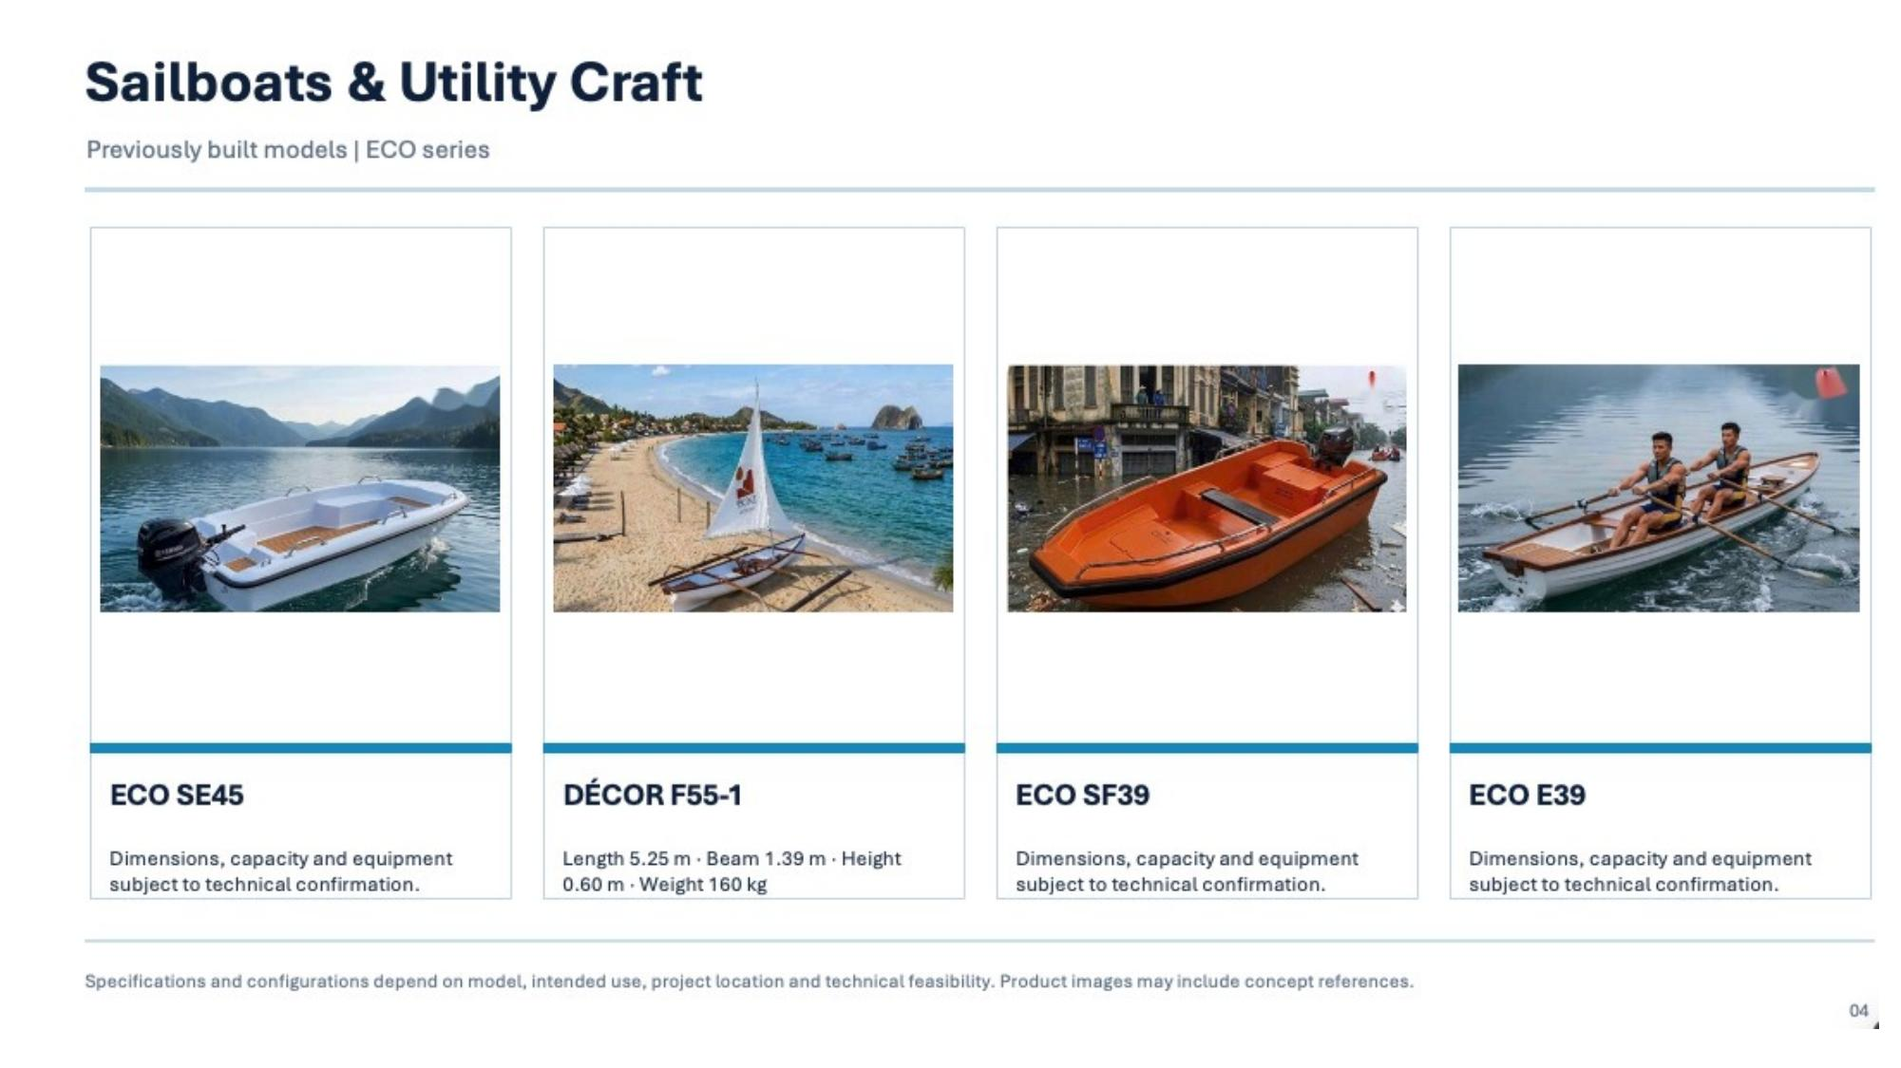
SECTION 2 · SAILING CRAFT
Sailboats & Leisure Yachts
Previously built models — ECO series
NAUTIVA

Slide 8
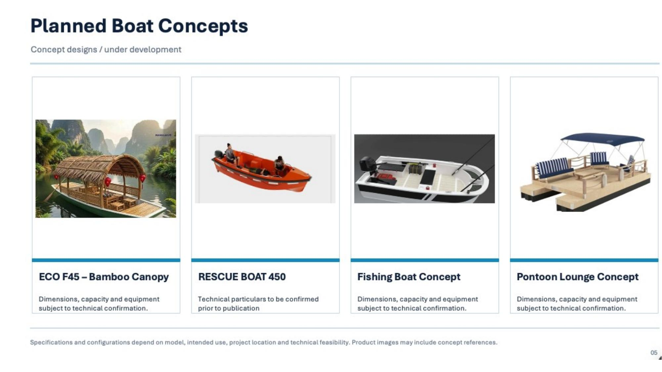
SECTION 3 · CONCEPT FLEET
Future Vessels in Development
Concept designs under development
NAUTIVA

Slide 9
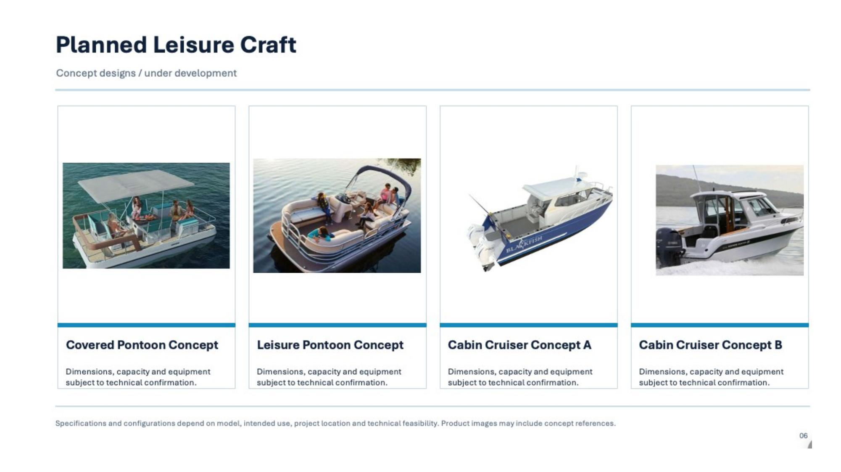
SECTION 3 · CONCEPT FLEET
Leisure & Cruising Concepts
Concept designs under development
NAUTIVA

Slide 10
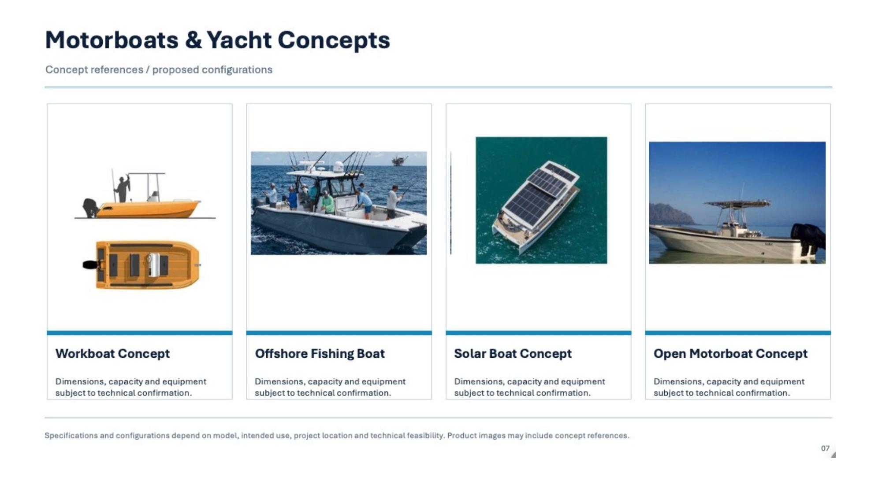
SECTION 3 · MOTOR VESSELS
Motorboats & Yacht Concepts
Concept designs under development
NAUTIVA

Slide 11
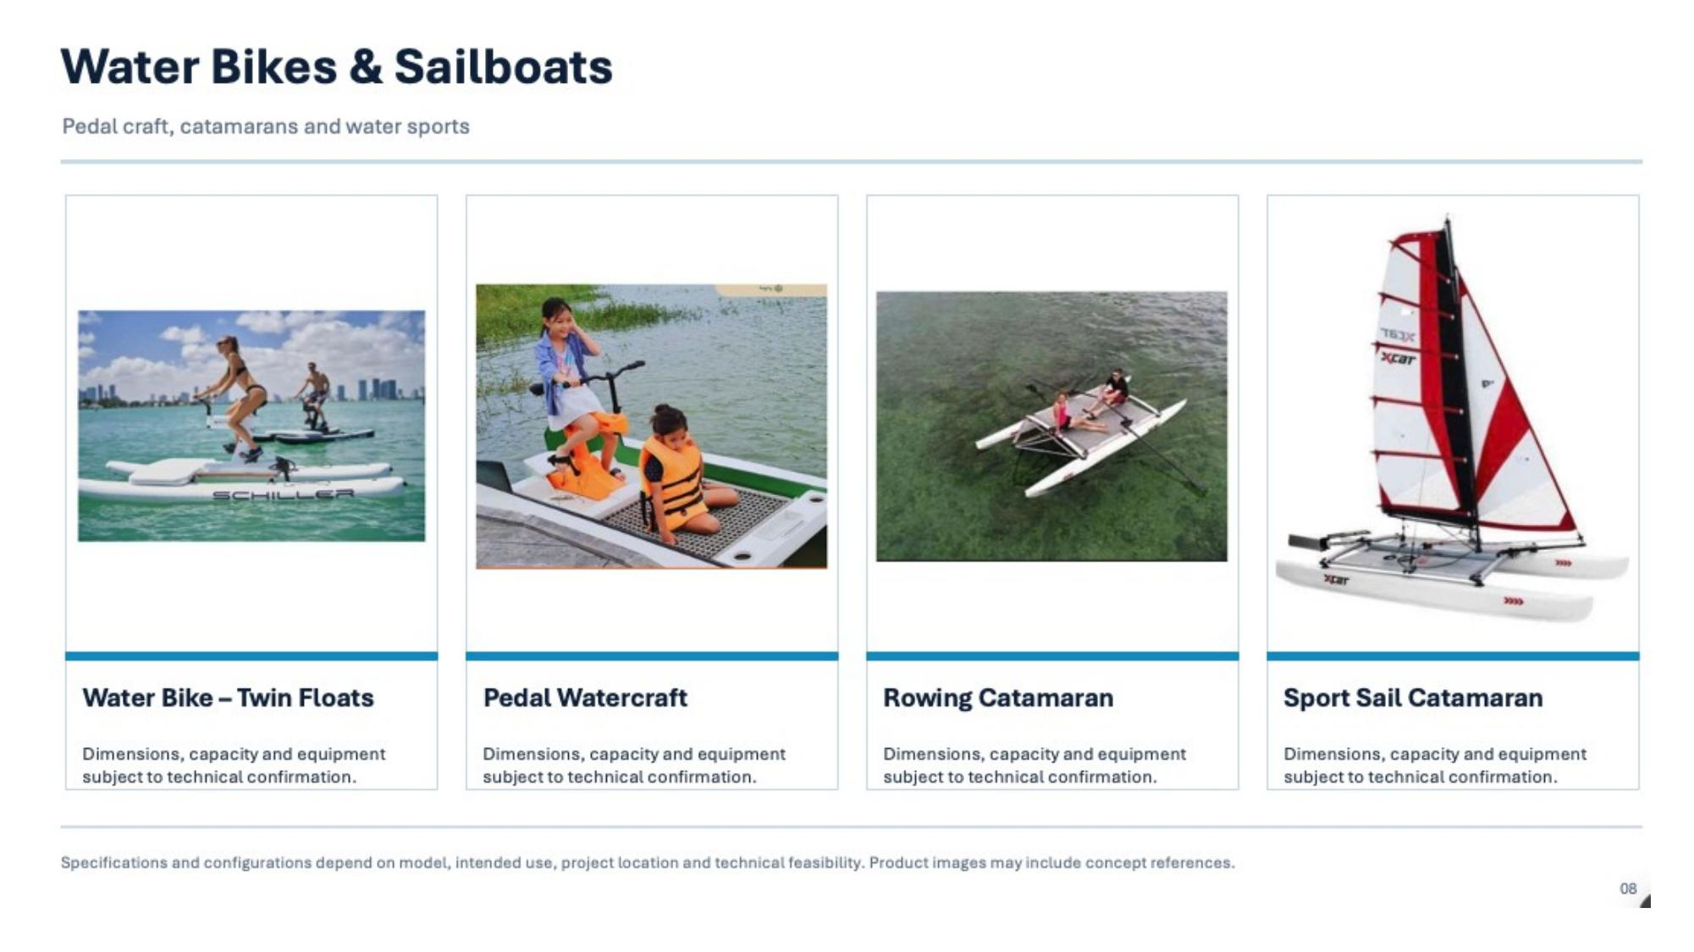
SECTION 3 · WATER SPORT
Water Bikes, Catamarans & Sailboats
Paddle craft, catamarans and sport sailing
NAUTIVA

Slide 12
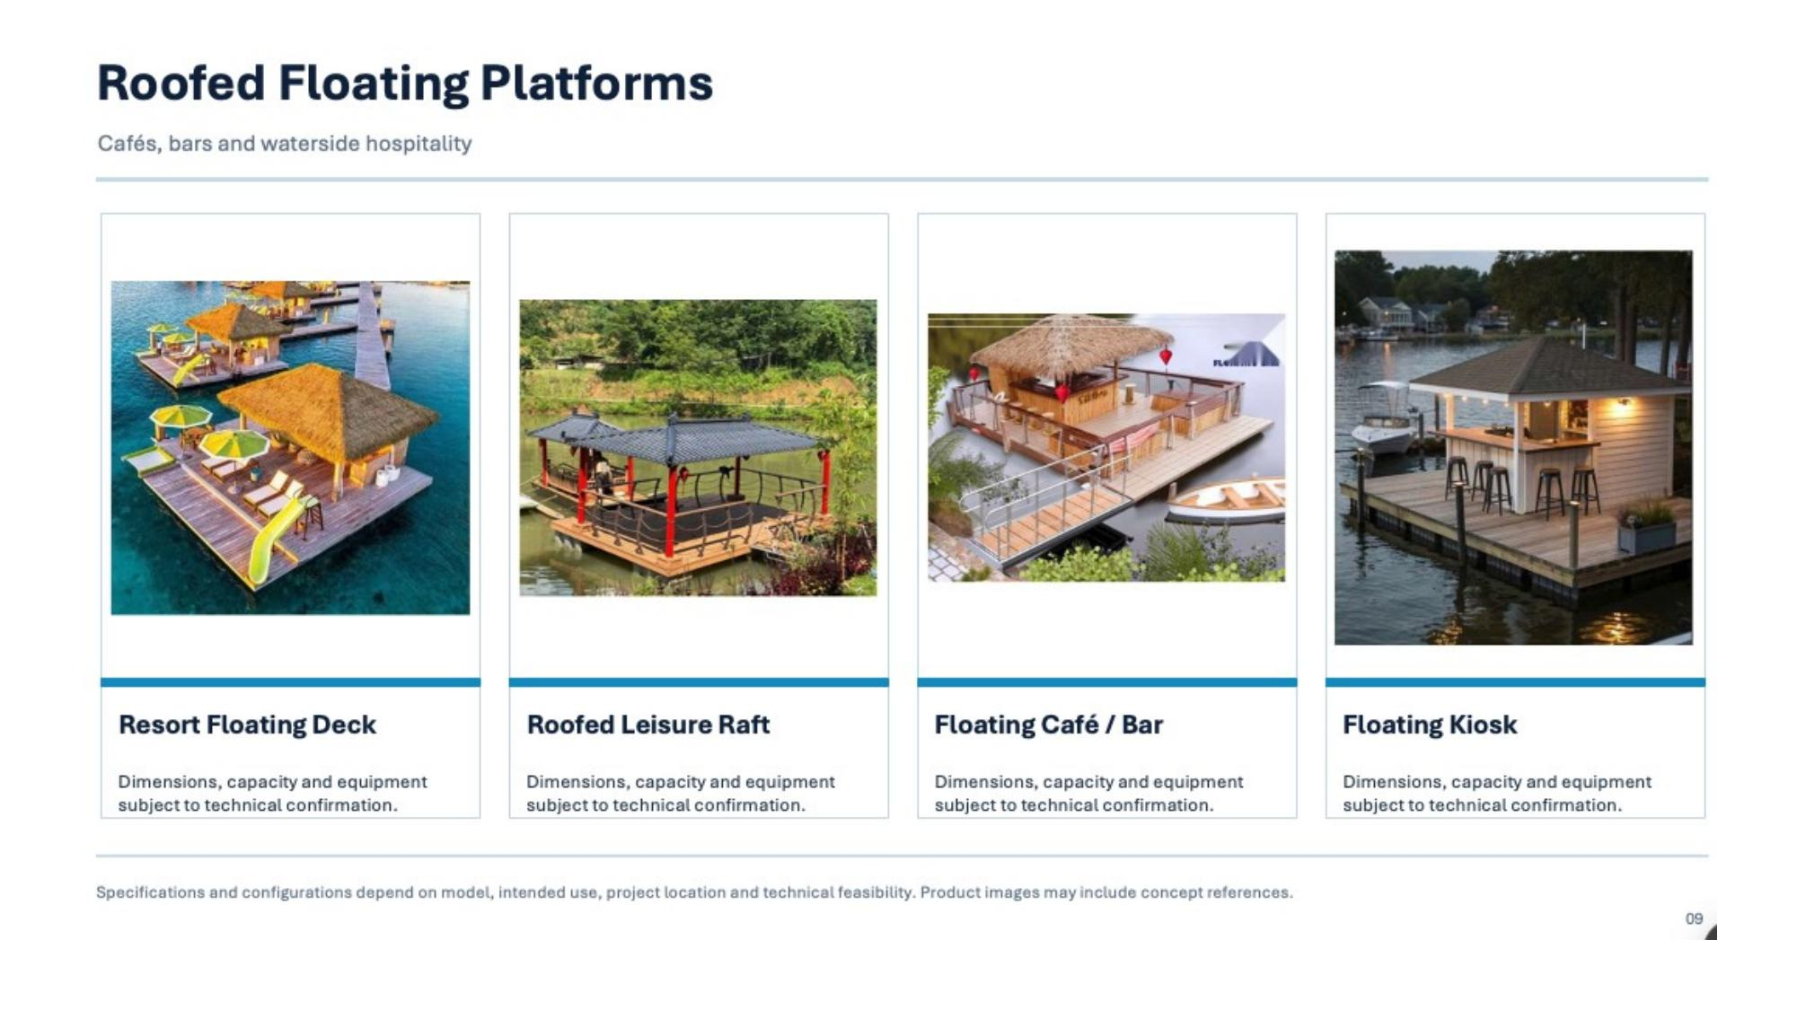
SECTION 4 · FLOATING STRUCTURES
Roofed Floating Platforms
Resort decks, leisure rafts, floating cafés and kiosks
NAUTIVA

Slide 13
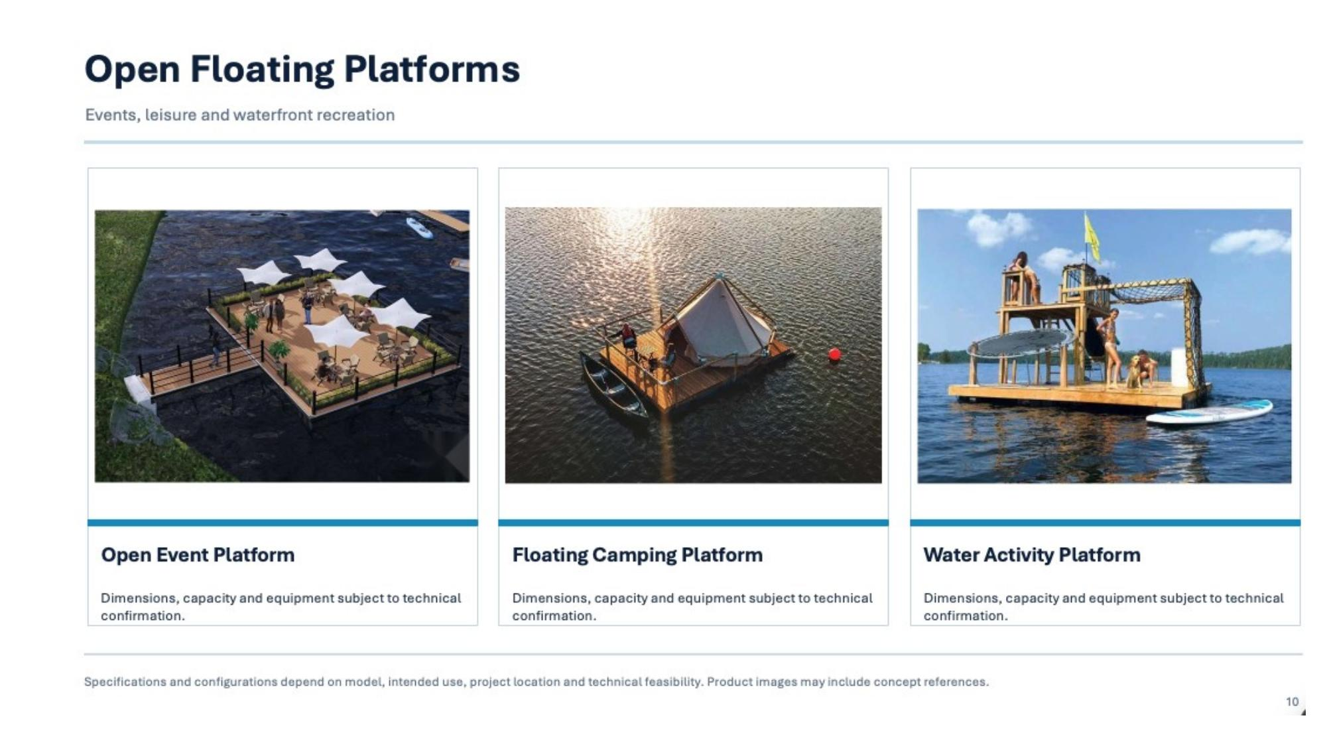
SECTION 4 · FLOATING STRUCTURES
Open Event & Activity Platforms
Events, leisure and waterfront recreation
NAUTIVA

Slide 14
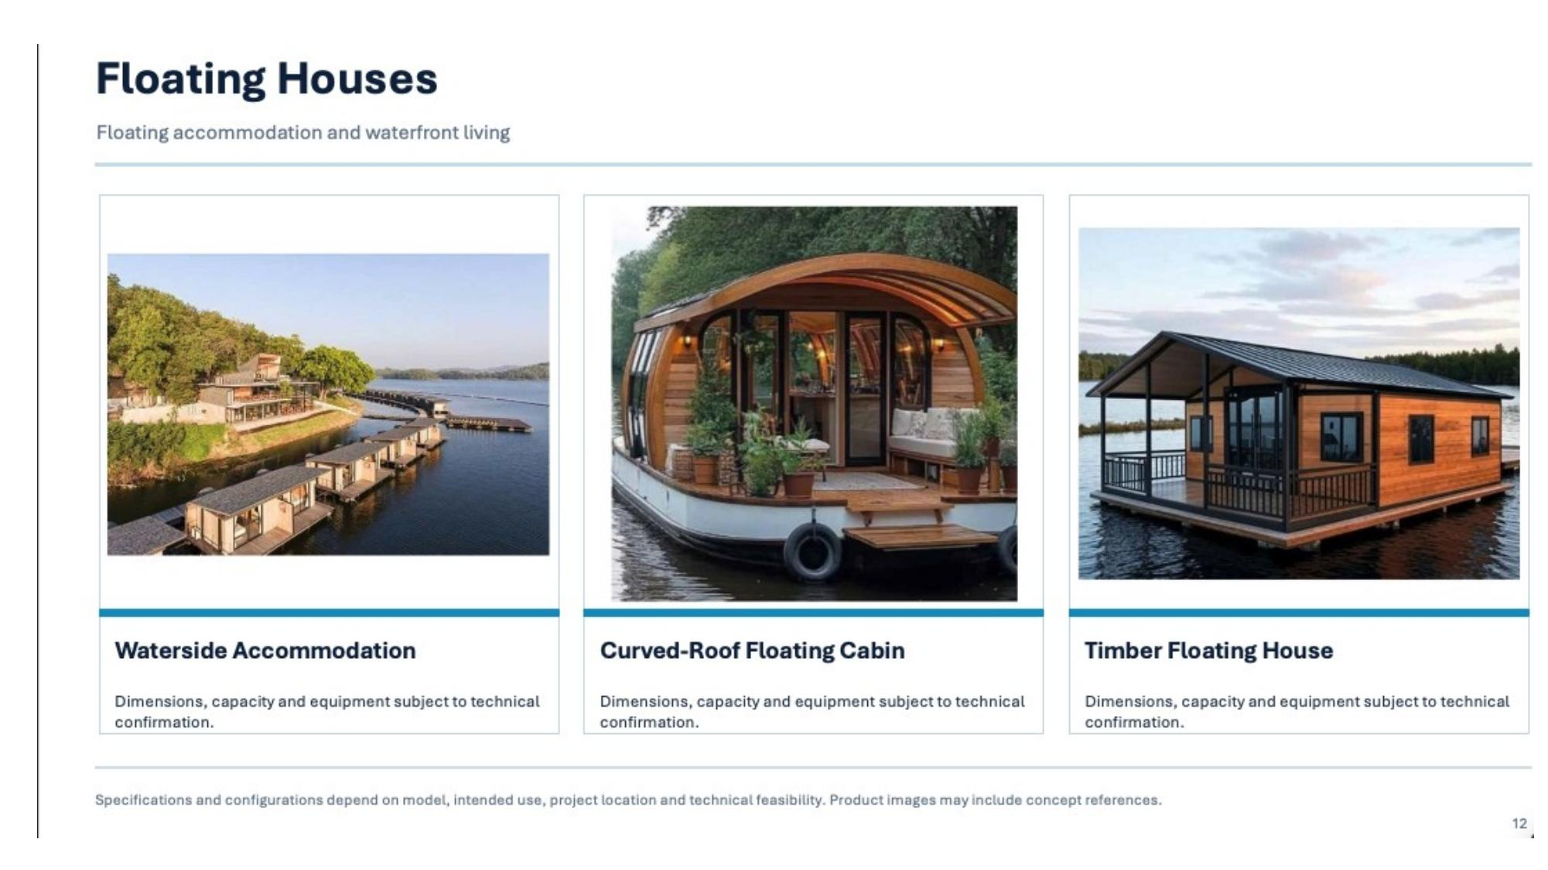
SECTION 4 · FLOATING RESIDENCES
Floating Houses & Waterside Living
Floating accommodation and waterfront living
NAUTIVA

Slide 15
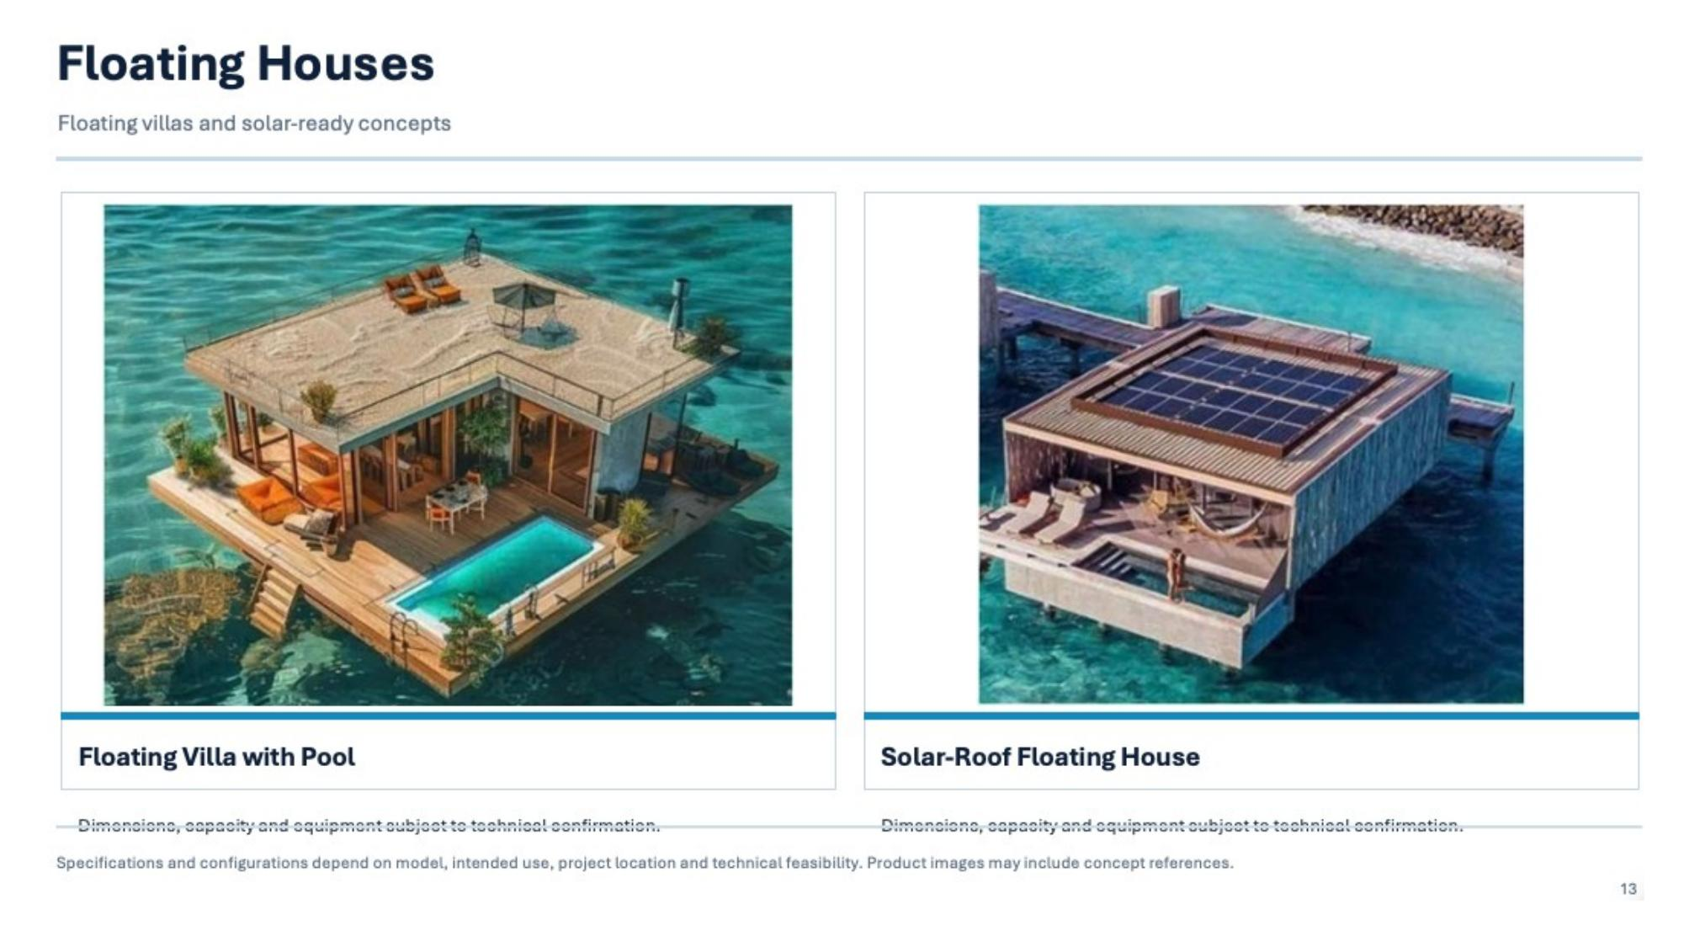
SECTION 4 · FLOATING RESIDENCES
Luxury Water Villas
Floating water homes — concept references
NAUTIVA

Slide 16
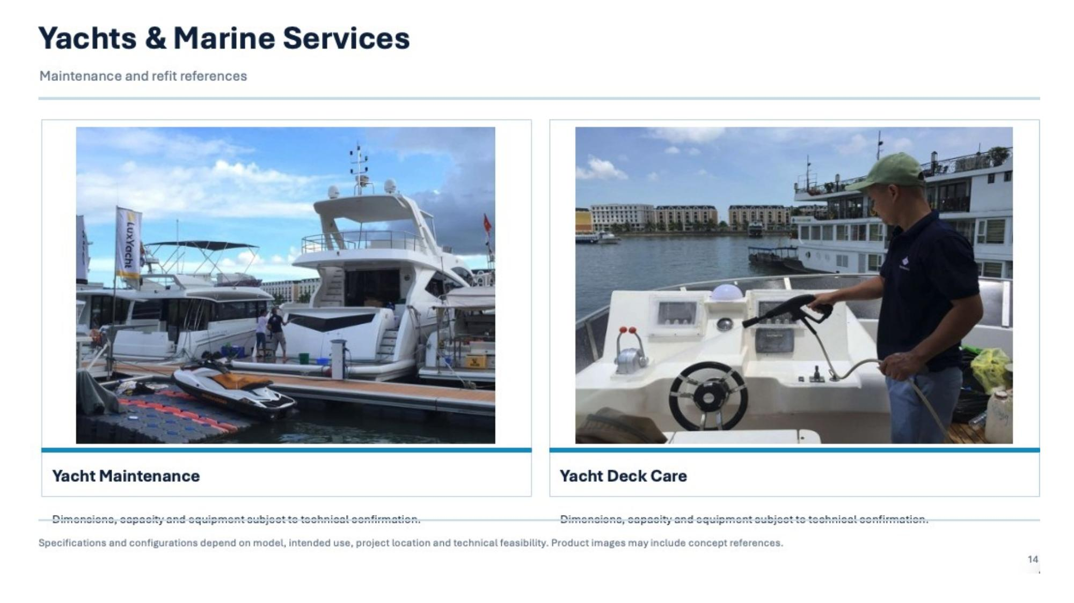
SECTION 5 · MARINE SERVICES
Yacht Maintenance & Care
Maintenance and refit references
NAUTIVA

Slide 17
TECHNICAL SPECIFICATIONS
SECTION 6 · PRECISION-ENGINEERED MARINE CRAFT · KEY REFERENCE DATA
Model | Length | Beam | Height | Capacity | Weight | Material | Propulsion
Rescue Boat 450 | 4.5 m | 1.2 m | ~0.7 m | 4–6 pax | ~150 kg | Composite | Outboard engine
ECO E35 | 3.5 m | 1.25 m | 0.5 m | 3–4 pax | ~80 kg | Composite & Teak | Paddle / Outboard
Décor ECO S55 | 5.25 m | 1.35 m | 0.6 m | 4–5 pax | ~160 kg | Composite & Wood | Paddle / Outboard
Décor F55-1 | 5.25 m | 1.39 m | 0.6 m | 4–5 pax | ~160 kg | Composite & Wood | Paddle / Outboard
ECO F45 | 4.5 m | 1.25 m | 0.41 m | 6–7 pax | ~115 kg | Twin-hull Composite | Paddle / Outboard
ECO F58 | 5.0 m | 2.2 m | 0.3 m | 4–8 pax | ~460 kg | Composite | Paddle / Outboard
ECO F55 | 5.5 m | 1.3 m | 0.7 m | ~6 pax | ~110 kg | Twin-hull Composite | Paddle / Outboard
ECO SF48 | 4.8 m | 1.8 m | ~0.6 m | 4 pax | — | Composite | Outboard engine
ECO C31 | 3.1 m | 0.95 m | 0.25 m | 2 pax | ~42 kg | Composite & Wood | Kayak paddle
ECO E39 | 3.95 m | 1.3 m | 0.44 m | 3–4 pax | — | Twin-hull Composite | Rowing / Outboard
* Specifications are indicative only. Confirm all technical data with NAUTIVA engineering team prior to order.

Slide 18
01
MARINE ENGINEERING EXPERTISE
Seasoned naval architects and composite engineers with proven experience across domestic and international maritime projects.
WHY
NAUTIVA
02
PRECISION MANUFACTURING
Rigorous quality control from raw material selection through composite hull fabrication, surface finishing, and final inspection.
03
DURABLE COMPOSITE CONSTRUCTION
Marine Excellence.
Crafted with Intention.
Corrosion-resistant hulls engineered for freshwater and saltwater environments — optimized for structural integrity, weight efficiency, and low maintenance.
04
BESPOKE CUSTOMIZATION
Colors, deck layouts, seating configurations, propulsion systems, and accessories — each vessel tailored to your exact specification.
SECTION 7

Slide 19
OUR COMMITMENT
SECTION 8 · QUALITY & AFTER-SALES EXCELLENCE · EVERY VESSEL. EVERY CLIENT. EVERY DETAIL.
01
AUTHENTIC PRODUCTS & REFERENCES
04
MAINTENANCE & COMPOSITE REPAIR
Real product photography and verified project references. No renderings presented as reality, no exaggeration — only what we have built and delivered.
Full-service composite hull care: scheduled maintenance, surface refinishing, structural repair, and related marine technical support.
02
TRANSPARENT TECHNICAL SPECIFICATIONS
05
DIRECT ENGINEERING CONSULTATION
Clear, model-specific performance data and configuration options, provided in full — no ambiguity, no hidden constraints.
Speak directly with our naval engineers to refine vessel selection, explore customization options, and align technical requirements with your project.
03
WARRANTY & AFTER-SALES SUPPORT
Structured warranty terms and responsive technical assistance, with all service conditions clearly confirmed prior to purchase.

Slide 20
CONTACT US
DISCOVER
YOUR VESSEL
HOTLINE / ZALO
Contact us for details
EMAIL
Contact us for details
WEBSITE
nautiva.vn
Crafted with Precision. Built for Life on Water.
Explore our collection or speak directly with our engineers to discuss
vessel specifications, customization options, and delivery timelines.
ADDRESS
Hưng Yên, Vietnam
Request a Consultation
View Full Catalogue
NAUTIVA

